Slide 1
Is the following a property that holds for all non-decreasing positive functions f and g? (True=Yes/ False=No) If f(n) = O(n²) for c=1 and n₀=0 and g(n) = Theta(n²) for n₀=0 and c₁ =1 and c₂=1 then f(n) = O(g(n)). - True
What is the basic operation (that which is executed maximum number of times) in the following code?
reverse(a):
for i = 1 to len(a)-1
x = a[i]
for j = i downto 1
a[j] = a[j-1]
a[0] = x - a[j] = a[j-1]
Consider the following algorithm
1 Bubble-sort(a)
2 for i = a.length() to 1
3 for j = 1 to i-1
4 if a[j]>a[j+1]
5 swap(a[j],a[j+1]);
6 end if
What is its basic operation (write the line number of code which would define the execution time of the code)? - 4
Which of the following can be used to compare two algorithms? – growth rates of the two algorithms
Let W(n) and A(n) denote respectively, the worst case and average case running time of an algorithm executed on an input of size n. which of the following is ALWAYS TRUE? - A(n) O(W(n))
Select correct inequality for the asymptotic order of growth of the below function. That is, as the value of n becomes very large what is the relation between the two functions. – n < n^2
What is the correct loop invariant for the below code:
for i in range(len(A)): # in pseudo-code for i=0,...,len(A)-1
answer += A[i]
return answer
At the start of iteration i of the loop, the variable answer should contain the sum of the numbers from the subarray A[0:i-1].
When we say algorithm A is asymptotically more efficient than B, what does that imply? - A will always be a better choice for large inputs

Slide 2
Read and Analyze Pseudocode: Consider the following algorithm (In the algorithm, A[0..n-1] refers to an array of n elements i.e. A[0], A[1]… A[n-1]) a. What does this algorithm compute? i This algorithm finds the minimum and maximum values in an array. b. What is its basic operation (i.e. the line of code or operation that is executed maximum number of times)? i If A[i] < minval and if A[i] > maxval c. How many times is the basic operation executed? i The basic operation is executed n-1 times, where n is the number of elements in the array. d. What is the time complexity of this algorithm? i O(n) Classified(A[0..n-1]): minval = A[0] maxval = A[0] for i = 1 to n-1: if A[i] < minval: minval = A[i] if A[i] > maxval maxval = A[i] return maxval – minval
Using mathematical induction prove below non-recursive algorithm:
def reverse_array(Arr):
n = len(Arr) i = (n-1)//2 j = n//2 while(i>= 0 and j <= (n-1)):
a. Write the loop invariant of the reverse_array function. i At the start of each iteration of the while loop, the subarray Arr[i+1] and Arr[j-1] is reversed.
b. Prove correctness of reverse_array function using induction. i Loop invariant: At the start of each iteration of the while loop, the subarray Arr[0:i+1] is reversed.
ii Initialization: At the start of the first iteration the loop invariant states: At the start of each iteration of the while loop, the subarray Arr is reversed. i is set to (n-1)//2 and j is set to n//2.
iii Maintenance: Assuming at the start of iteration (i>= 0 and j <= (n-1)) holds true, temp holds value Arr[i] and the algorithm performs the element swapping operation Arr[i] = Arr[j] and Arr[j] = temp. After the swap, the subarray Arr[0:i+1] is still reversed because the element at index i is now swapped with the element at index j, maintaining the reversed order.
iv Termination: The loop terminates when the condition i >= 0 and j <= (n-1) becomes false, which means that i becomes negative or j exceeds the array bounds.
temp = Arr[i] Arr[i] = Arr[j] Arr[j] = temp i = i-1 j = j+1

Slide 3
Which of the following correctly defines what a 'recurrence relation' is? - An equation (or inequality) that relates the n^{th} element of a sequence to its predecessors (recursive case). This includes an initial condition (base case).
Solve the following recurrence by giving the tightest bound possible.
T(n) = 4T(n/4) + 4n – Theta(nlogn)
What would be the time complexity of the following algorithm?
int sum = 0;
for (i = 0; i < n; i++) {
for (j = 0; j < n; j++) {
for (k = 0; k < n; k++) {
if (i == j == k) {
for (l = 0; l < n*n*n; l++) {
sum = i + j + k + l;
}
}
}
}
}
- Theta(n^4)
What would be the time complexity of the following algorithm?
reverse(a):
for i = 1 to len(a)-1
x = a[i]
for j = i downto 1
a[j] = a[j-1]
a[0] = x
- O(n^2)
What is the solution of T(n)=2T(n/2)+n/logn? using the Master theorem? – T(n) = Theta(nlog2n)
Given the following algorithm
foo(n)
if n <= 1
return 1
else
x = foo(n-1)
for i = 1 to n
x = x + i
return x
Determine the asymptotic running time. Assume that addition can be done in constant time. – Theta(n^2)
Which of the following equations correctly represent the factorial function.
Factorial of a number n is given by:
- f(n) = n * f(n-1)
We can use Divide and Conquer technique to solve a problem in which of the following scenarios? - We can break the problem into several subproblems that are similar to the original problems but smaller in size
Which of the following recurrence relations is correct representation of the towers of Hanoi problem that was discussed in the exploration? – F(n) = 2F(n-1)+1

Slide 4
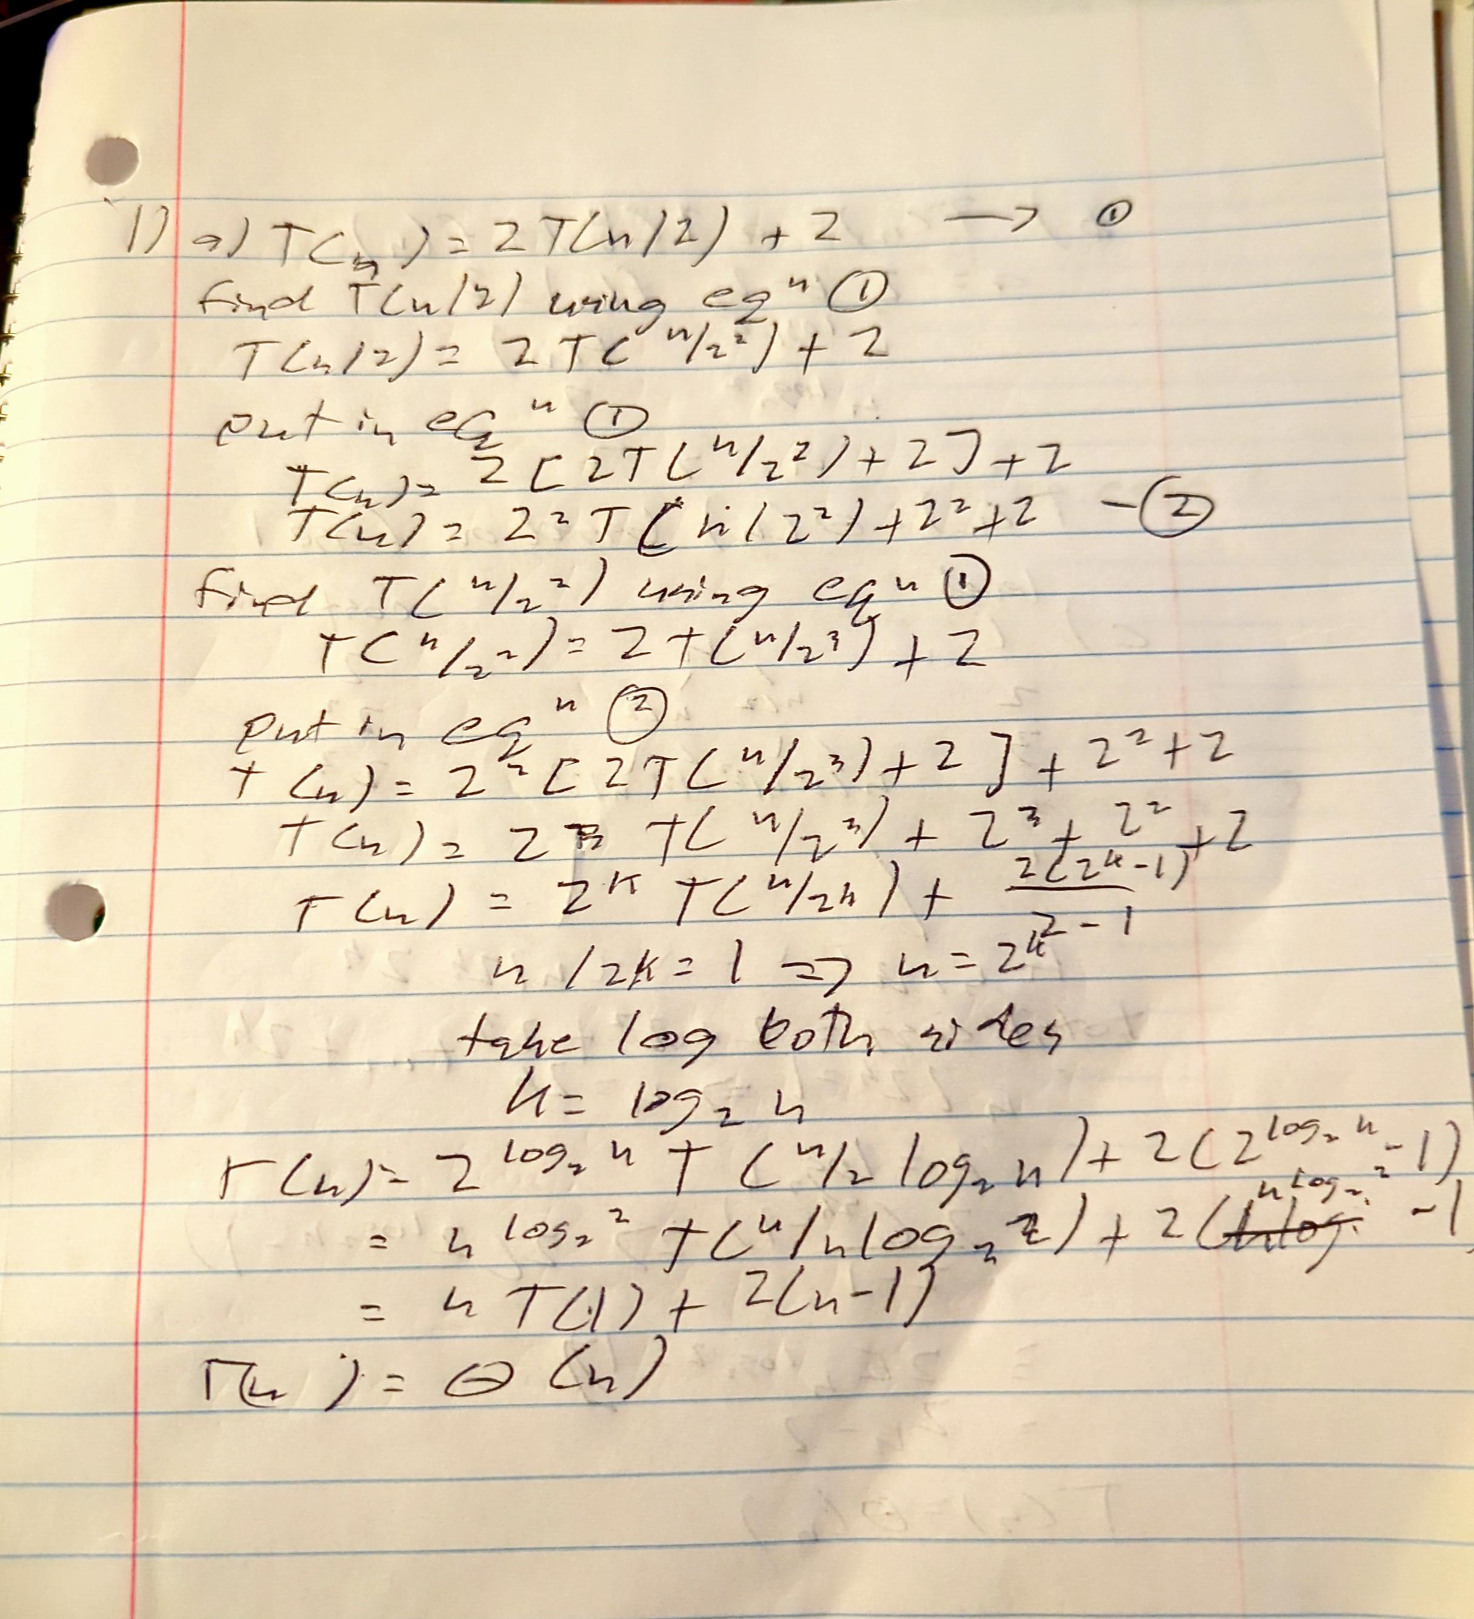
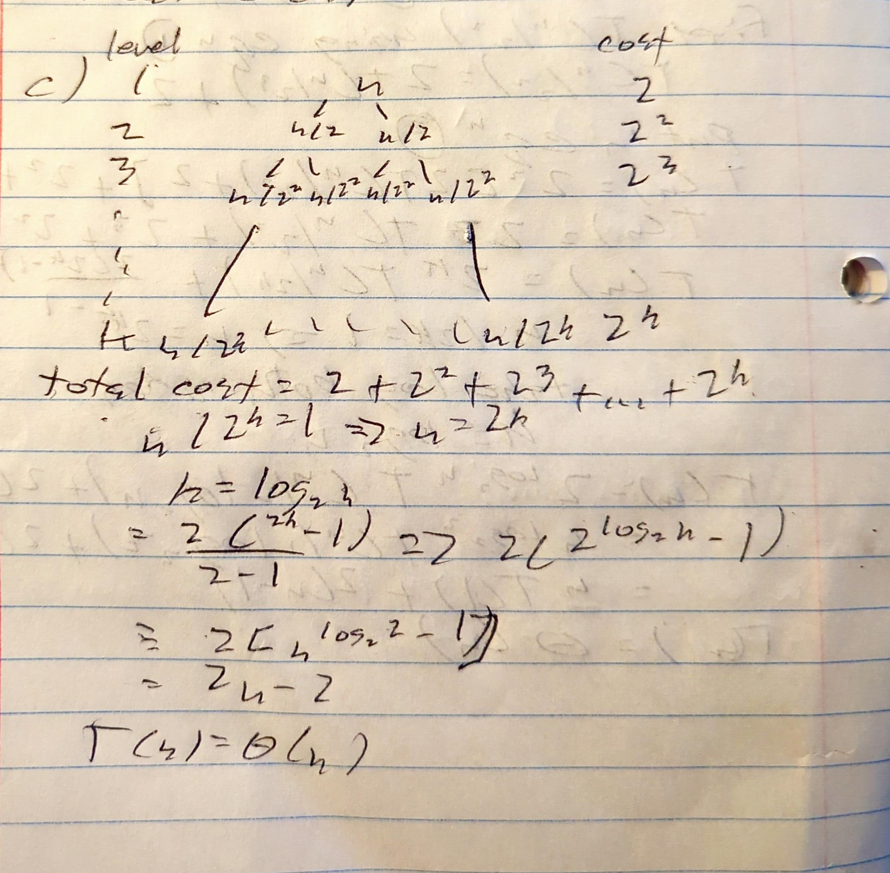
Solve recurrence relation using three methods: Write recurrence relation of below pseudocode that calculates 𝑥𝑛, and solve the recurrence relation using three methods that we have seen in the explorations. power2(x,n): if n==0: return 1 if n==1: return x if (n%2)==0: return power2(x, n//2) * power2(x,n//2) else: return power2(x, n//2) * power2(x,n//2) * x

Slide 5
3. Implement an algorithm using divide and conquer technique: Given two sorted arrays of size m and n respectively, find the element that would be at the kth position in combined sorted array. a. Write a pseudocode/describe your strategy for a function kthelement(Arr1, Arr2, k) that uses the concepts mentioned in the divide and conquer technique. The function would take two sorted arrays Arr1, Arr2 and position k as input and returns the element at the kth position in the combined sorted array. i Function kethElement(Arr1, Arr2, k): if Arr1 is empty: return Arr2[k - 1] if Arr2 is empty: return Arr1[k - 1] if k is 1:
function kthElement(Arr1, Arr2, k):
n1 = length(Arr1)
n2 = length(Arr2)
if n1 == 0:
return Arr2[k - 1]
endif
if n2 == 0:
return Arr1[k - 1]
endif
if k == 1:
return min(Arr1[0], Arr2[0])
endif
mid1 = min(n1, k // 2)
mid2 = min(n2, k // 2)
if Arr1[mid1 - 1] < Arr2[mid2 - 1]:
return kthElement(Arr1[mid1:], Arr2, k - mid1)
else:
return kthElement(Arr1, Arr2[mid2:], k - mid2)
endif
endfunction

Slide 6
What are the major required aspects in a problem in order to apply Dynamic Programming Technique? - Optimal Substructure and Overlapping subproblems
The difference between Divide and Conquer Approach and Dynamic Programming is- Whether the sub-problems overlap or not
In the Longest Common Subsequence problem assume we are comparing two strings of lengths m and n. In the bottom-up approach the solution we build a 2-Dimensional array called Cache[m][n]. The final solution was obtained by accessing which element of the cache? - The element in the bottom right corner of the cache[m][n]
In [bottom-up] we start with the base case and build the solution starting from base case. In [top-down] we start solving the the bigger problem proceed towards the base case.
In which of the following approaches we start with the base case and proceed to solve the bigger subproblems? - Bottom-up Approach
A binary search algorithm searches for a target value within a sorted array. Binary search compares the target value to the middle element of the array; if they are unequal, the half in which the target cannot lie is eliminated and the search continues on the remaining half until the target value is found or until a search can no longer be performed. This problem can be solved using which of the techniques? - Divide and Conquer
In dynamic programming, the technique of storing the previously calculated values is called - Memoization

Slide 7
function dna_match_topdown(DNA1, DNA2) memo = {} function helper(i, j) if i == 0 or j == 0 return 0 endif if (i, j) is in memo return memo[(i, j)] endif if DNA1[i - 1] is equal to DNA2[j - 1] result = 1 + helper(i - 1, j - 1) else result = max(helper(i - 1, j), helper(i, j - 1)) endif memo[(i, j)] = result return result endfunction return helper(length(DNA1), length(DNA2)) endfunction
function dna_match_bottomup(DNA1, DNA2) m = length(DNA1) n = length(DNA2) table = 2D array of size (m + 1) x (n + 1) filled with 0 for i from 1 to m + 1 for j from 1 to n + 1 if DNA1[i - 1] is equal to DNA2[j - 1] table[i][j] = 1 + table[i - 1][j - 1] else table[i][j] = max(table[i - 1][j], table[i][j - 1]) endif endfor endfor return table[m][n] endfunction

Slide 8
Given two integer arrays to represent weights and profits of ’N’ items, find a subset of these items that will give us maximum profit such that their cumulative weight is not more than a given number ‘C’. Best technique to solve this problem is? - Dynamic Programming
We are given an array of numbers and we are asked to find an optimal solution to maximize the sum of numbers (i.e continuous subsequence that has maximum sum). if the order of the input numbers were altered or if we use a different algorithm, we will always end up with the same combination of numbers as answer. - False
In the o-1 knapsack recurrence formula f(x,i) = max{ v_{i} + f[x-w_{i} , i-1] , f[x , i -1] }
The first part v_{i} + f[x-w_{i} , i-1] represents : adding the ith item to the knapsack
The second part f[x , i -1] represents: not adding the ith item to the knapsack
To find the optimal solution for 0-1 knapsack, what would be dimensions of the extra array that we would need? The knapsack has a capacity of W, and there are total of n items. Assume we are using the approach that was discussed in the exploration.
- Array[W+1][n+1]
Backtracking is used to solve which of the problems: - To find all possible solutions
What is the correct recurrence formula for the unbound knapsack problem that was discussed in the exploration?
Consider the weight of the items w[1..n], value of the items v[1..n]
- F(x) = max{ F[x-w_{i}] + v_{i} }

Slide 9
function max_independent_set(nums): dp = array of size length(nums) filled with 0 dp[0] = nums[0] dp[1] = nums[1] for i from 2 to length(nums) - 1: dp[i] = max(nums[i], nums[i] + dp[i - 2], dp[i - 2], dp[i - 1]) i = length(nums) - 1 lis = empty list while i > 1: if dp[i] == dp[i - 1]: i -= 1 elif dp[i] == nums[i]: lis.append(nums[i]) lis.reverse() return lis elif dp[i] == dp[i - 2] + nums[i]: lis.append(nums[i]) i = i - 2 else: i = i - 2 if i == 0: if (nums[i] > 0 or length(lis) == 0): lis.append(nums[i]) else: t = max(nums[0], nums[1]) if (t > 0 or length(lis) == 0): lis.append(t) lis.reverse() return lis endfunction
def powerset(inputSet):
result = []
backtrack(inputSet, [], result)
return result
def backtrack(inputSet, currentSet, result):
result.append(currentSet[:])
for i in range(len(inputSet)):
currentSet.append(inputSet[i])
backtrack(inputSet[i+1:], currentSet, result)
currentSet.pop()

